Slide 1


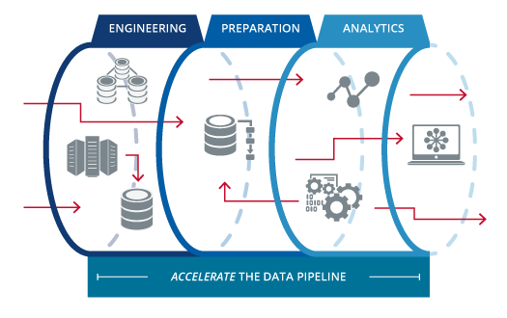
AWS DATA Engineering Training ( 10th - 18th October)

Slide 2


Amazon Web Services (AWS)

Slide 3
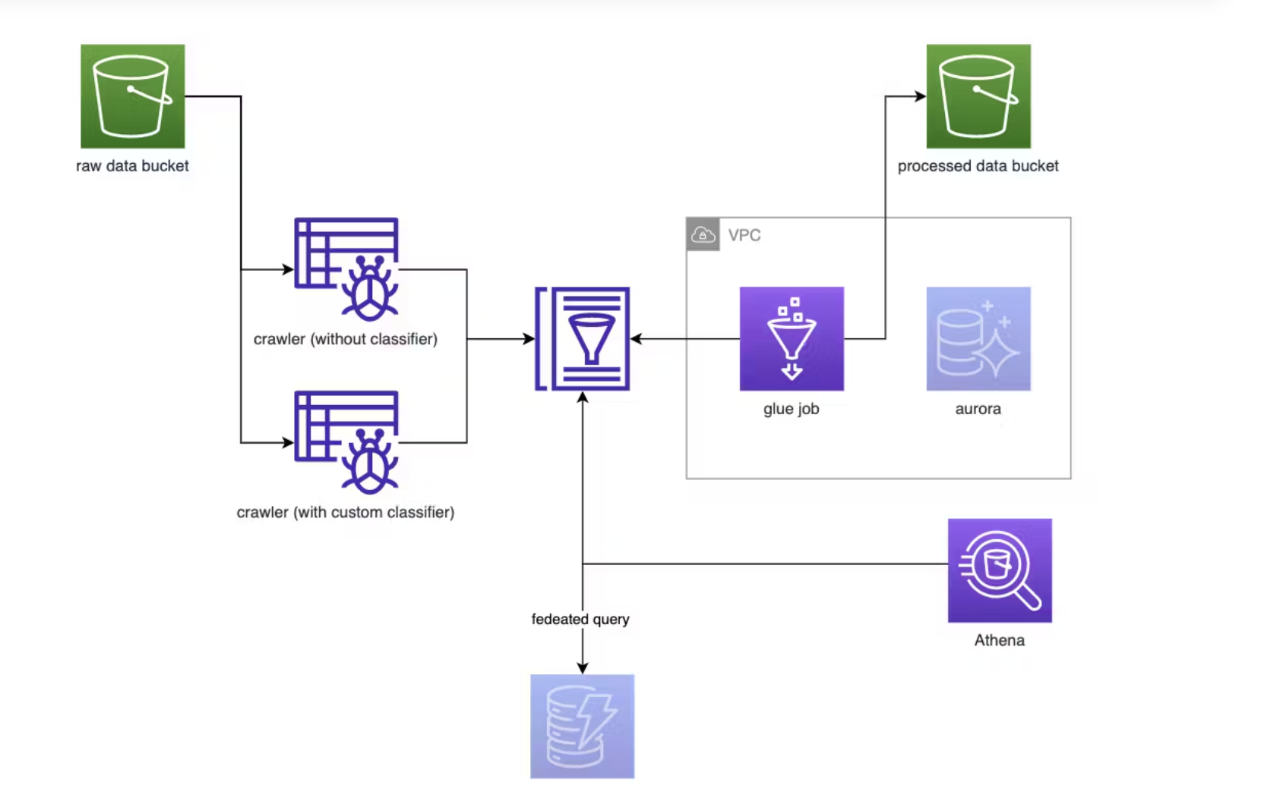
ETL Workflow

Slide 4






Data Quality & Transformation
Archived Bucket
Curated Bucket
Data Quality Fail
User
Raw bucket
Data Quality
Data Quality Pass
Data Transformation
Polling Message from SQS

